Slide 1
Optical Networks [EENGM0003]
Dr. George T. Kanellos
[gt.kanellos@bristol.ac.uk]

Slide 2
Part 2
Wavelength Division Multiplexing (WDM) Networks

Slide 3
Topics
WDM, DWDM and CWDM network concepts
WDM network components
Wavelength routing and switching technologies and architecture in WDM network
This session: passive star networks

Slide 4
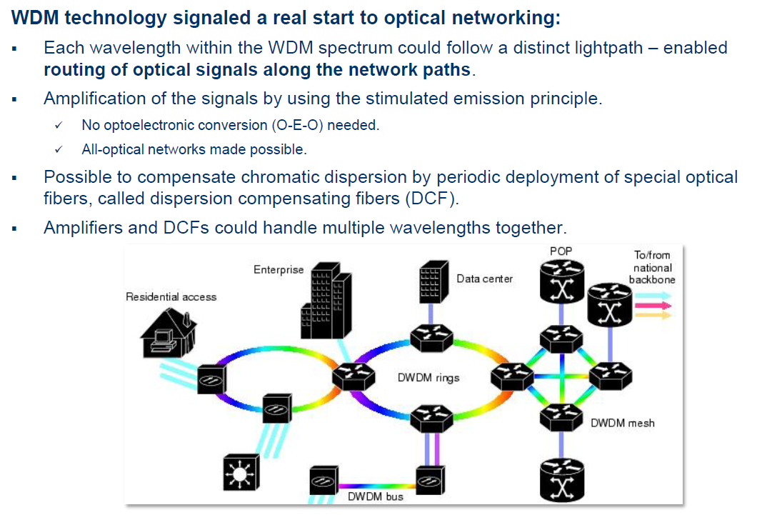
Wavelength Division Multiplexing (WDM)

Slide 5
WDM Networks Advantages
Format Independent
Information in completely different format can be transmitted over the same fibre
Each wavelength channel can use different format
Switching and Routing
Can be carried out using wavelength (optical) dependent devices
Scalability
Allows for growth on demand
Extra wavelength channels can be added when need arises

Slide 6
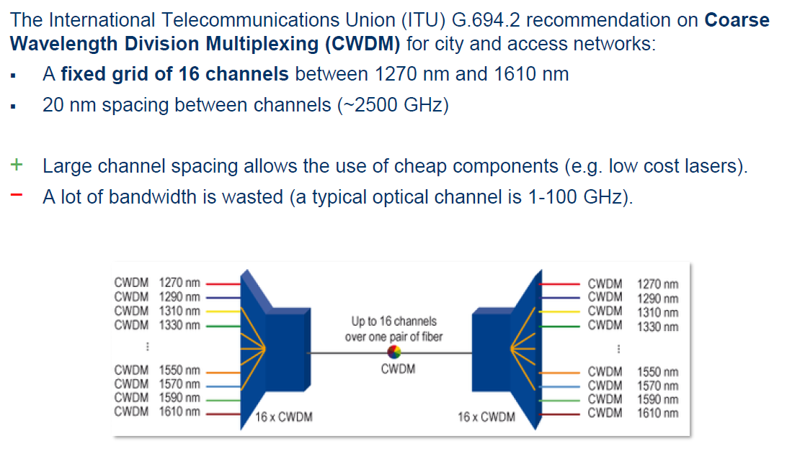
Optical Wavebands Definition - CWDM

Slide 7
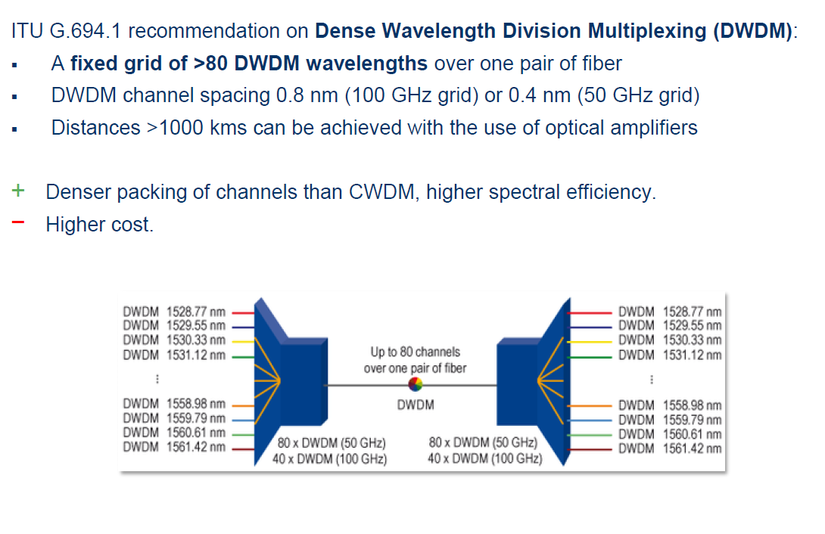
Optical Wavebands Definition - DWDM

Slide 8
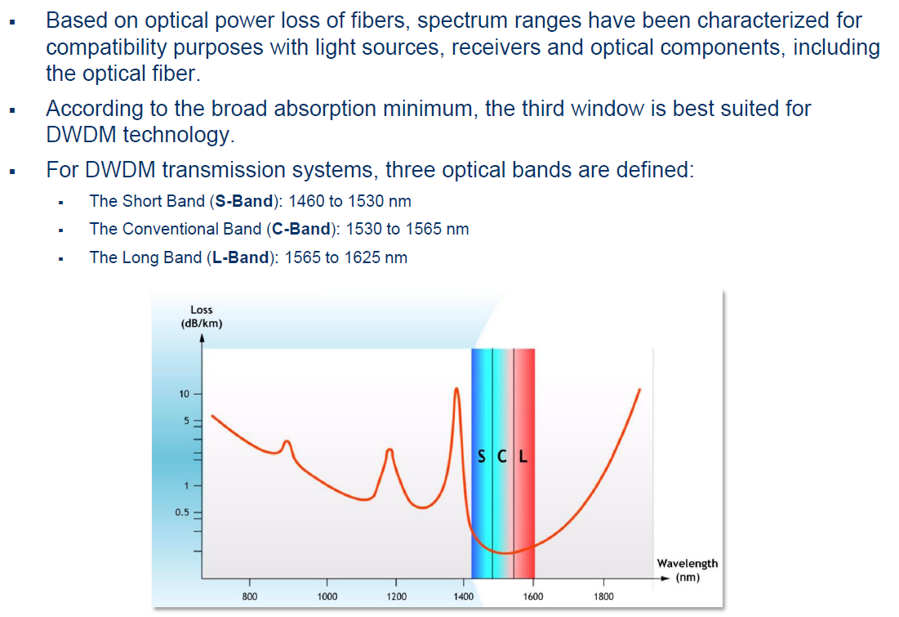
Optical Wavebands Definition - DWDM

Slide 9
Optical Wavebands Definition - DWDM
ITU grid is defined at 100 GHz spacing throughout the L, C and S-bands
50 GHz offset is an options for higher capacity systems

Slide 10
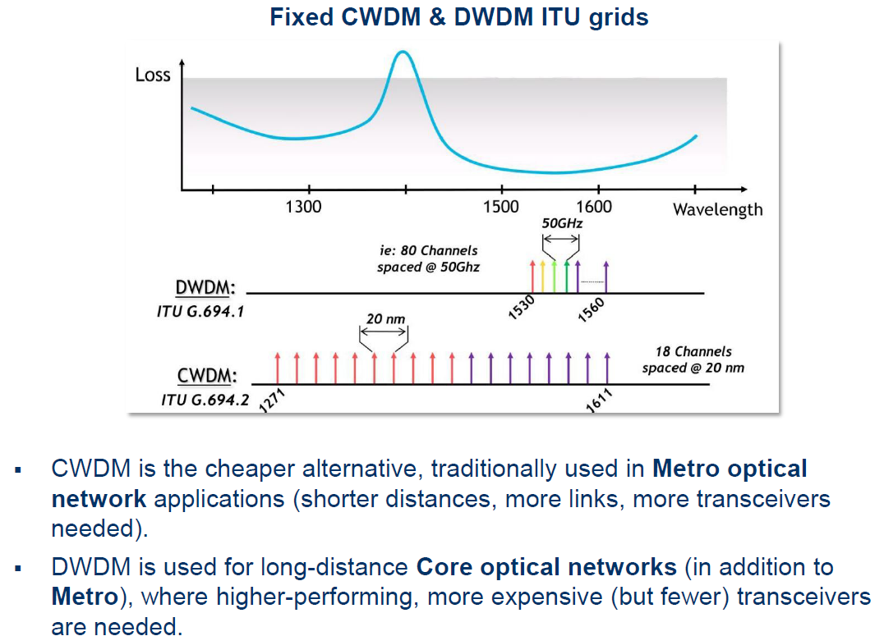
DWDM and CWDM summary

Slide 11
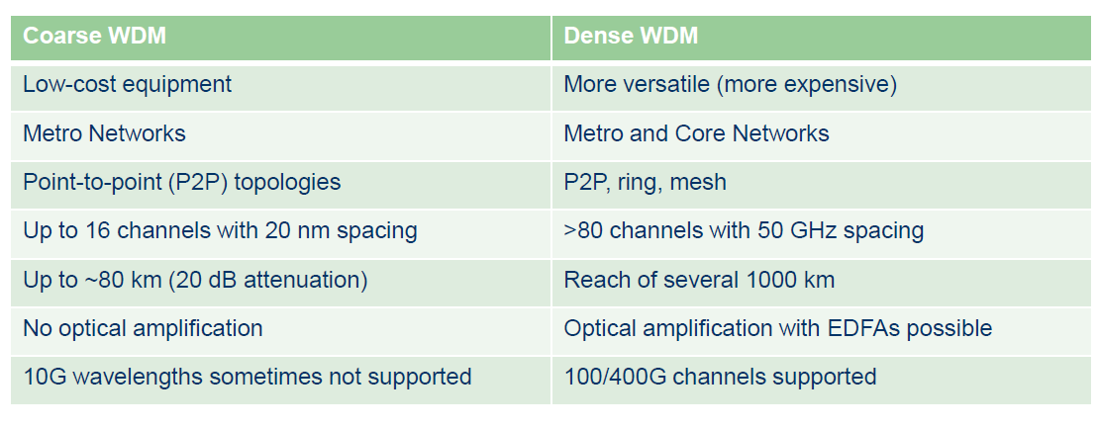
DWDM and CWDM summary

Slide 12
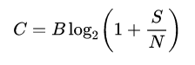
Link Capacity & Spectral Efficiency
Capacity of an optical communications channel is the maximum bit rate that can be transmitted without error for a given noise, bandwidth and power.
Capacity can be calculated independent of modulation, coding or decoding technique
Shannon–Hartley theorem
B Hz bandwidth and signal-to-noise ratio S/N

Slide 13
Link Capacity & Spectral Efficiency
For a WDM (Wavelength Division Multiplexed) optical communications system spectral Efficiency:
Spectral Efficiency : the ratio of bit rate to available bandwidth
It is directly dependent to modulation format and techniques
Example: Assuming data rate of 40 Gbps and channel spacing of 100GHz then will be SE = 0.4 bit/s/Hz

Slide 14
WDM Network Path
TX₁
λ₁
MUX
OADM
λ₁
RX₁
OXC
λ con
TX_{N}
λ_{N}
OADM
DeMUX
RX_{N}
λ_{N}
Terminal
Multiplexer/Demultiplexer: combines, separates wavelength channels
Optical Add-Drop Multiplexer: drops/adds individual wavelength channels
Optical Cross-connect (OXC): connects a wavelength channel on a particular input fibre to any outgoing fibre
Wavelength Converter: converts signal form one wavelength to another
Optical Amplifier: overcomes loss of fibre and OADM, OXC
Optical TX and RX WDM Transmitter and receiver
Optical Line Terminal TX and Mux or DeMux and Rx
Terminal

Slide 15
Simplest WDM network: WDM point-to-point network
λ₁
λ₁
RX₁
TX₁
MUX
DeMUX
TX_{N}
λ_{N}
RX_{N}
λ_{N}
Multiplexer/Demultiplexer: combines, separates wavelength channels
Optical Amplifier: overcomes loss of fibre and OADM, OXC
Optical TX and RX WDM Transmitter and receiver

Slide 16
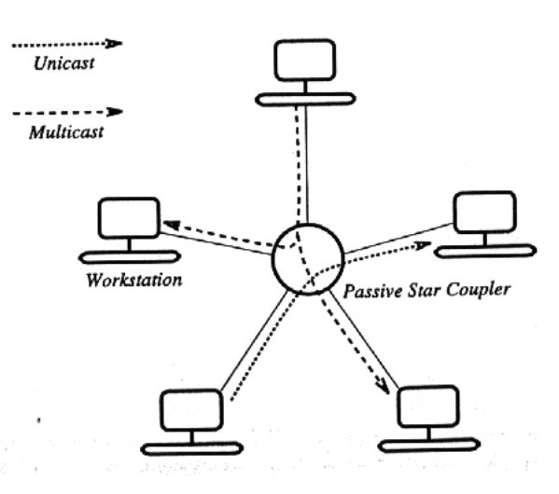
Passive star network

Slide 17
Passive Star WDM network
TX₁
λ₁
λ₁
RX₁
MUX
DeMUX
TX_{N}
λ_{N}
RX_{N}
λ_{N}
λ₁
λ₁
RX₁
TX₁
MUX
DeMUX
TX_{N}
λ_{N}
RX_{N}
50:50 coupler
λ_{N}

Slide 18
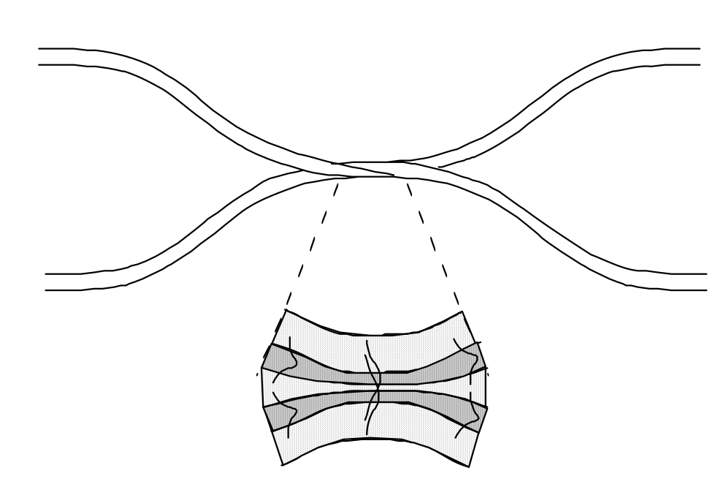
Optical Coupler Losses
Output Power
Input Power
P₂
P₁
λ₁
λ₁
Return Power
P₃
Output Power
P₄
λ₁
λ₁
Example:
Input power=200uw
P2= 85uw, P4=85uw, P3=6.3nw
For single Lambda
Coupling ratio : P₂/(P₄+P₂)
Excess Loss: P₁/(P₂+P₄)
Insertion Loss of P₁ to P₂ : P₁/P₂
Insertion Loss of P₁ to P₂ : P₁/P₄
Return Loss: P₃/P₁
3-dB coupler: P2 = P4 = 0.5 P1

Slide 19
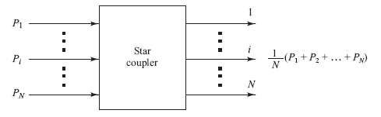
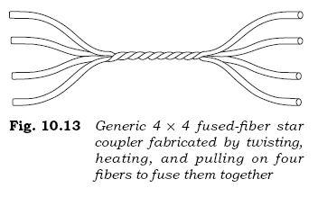
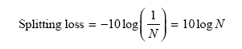
Star Couplers
In general, an N × N coupler has N inputs and M outputs

Slide 20
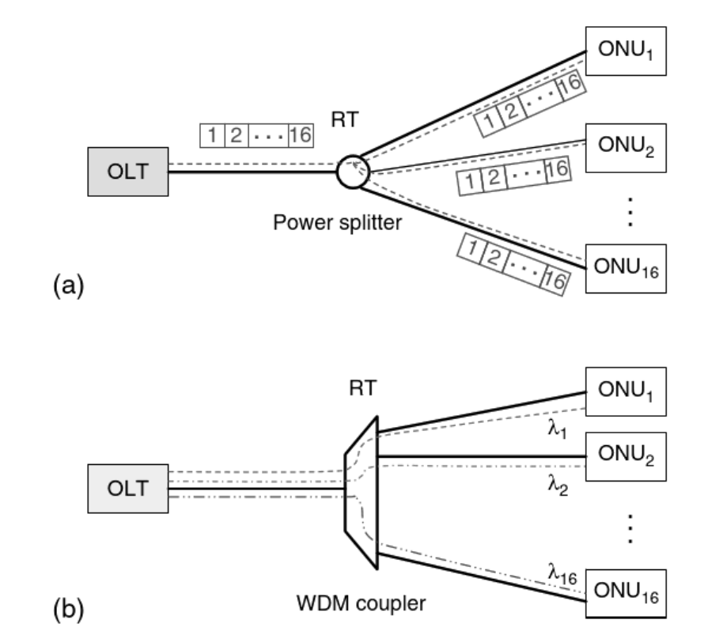
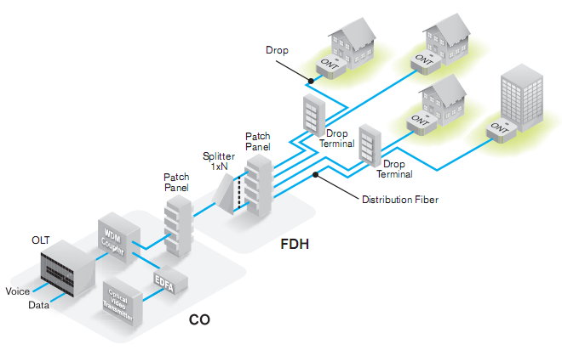
Application: Passive Optical Networks (PON)
Passive Optical Networks : Principles and Practice, edited by Cedric F. Lam, and Cedric F Lam, Elsevier Science & Technology, 2007.

Slide 21
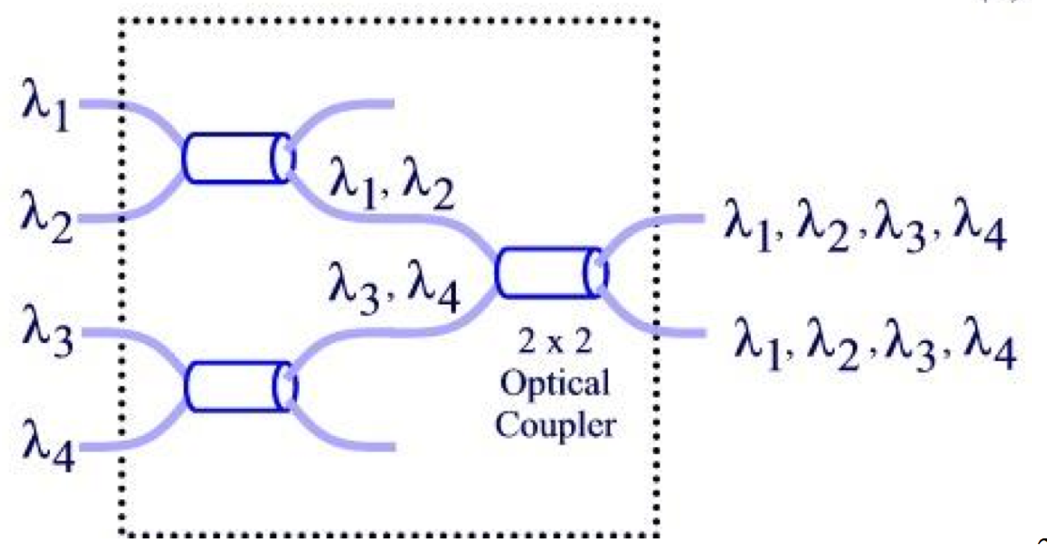
WDM Multiplexer
Combine optical channels and place them in single optical fibre Simplest is to employ star couplers
Uses passive couplers (no wavelength selection)
Loss 3dB of power at every split – scales badly with increased WDM channels; but is widely used as it is cheap...

Slide 22
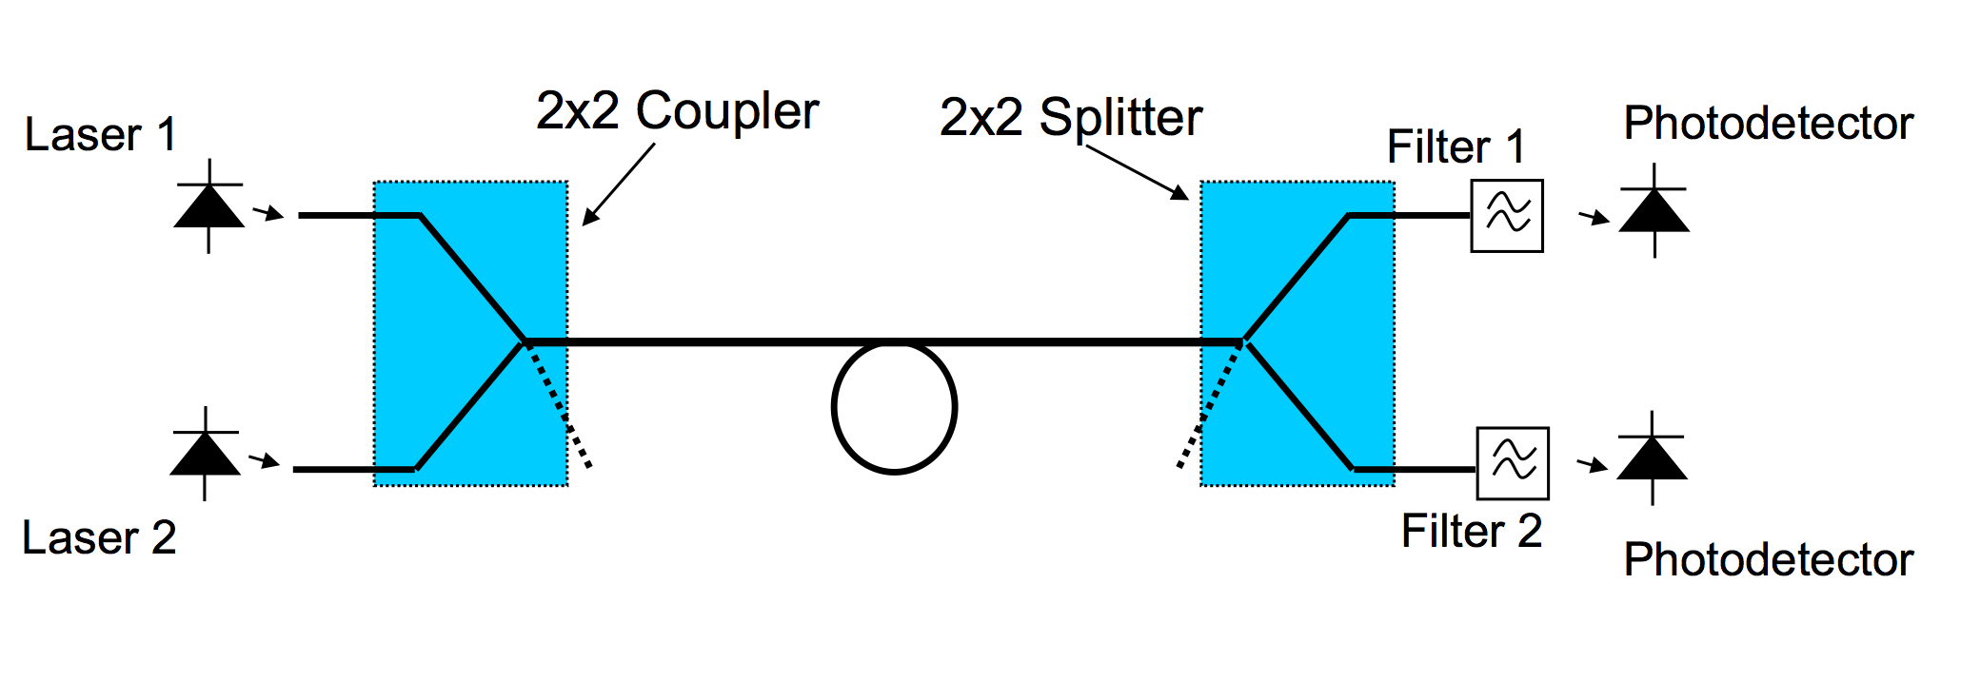
WDM DeMultiplexer
WDM DeMultiplexer is comprised of a splitter (coupler) and set of filters
Power divides according to the number of splits If Pin on one input, then output power = Pin/N, where N is the number of output ports In practice there are some additional losses

Slide 23
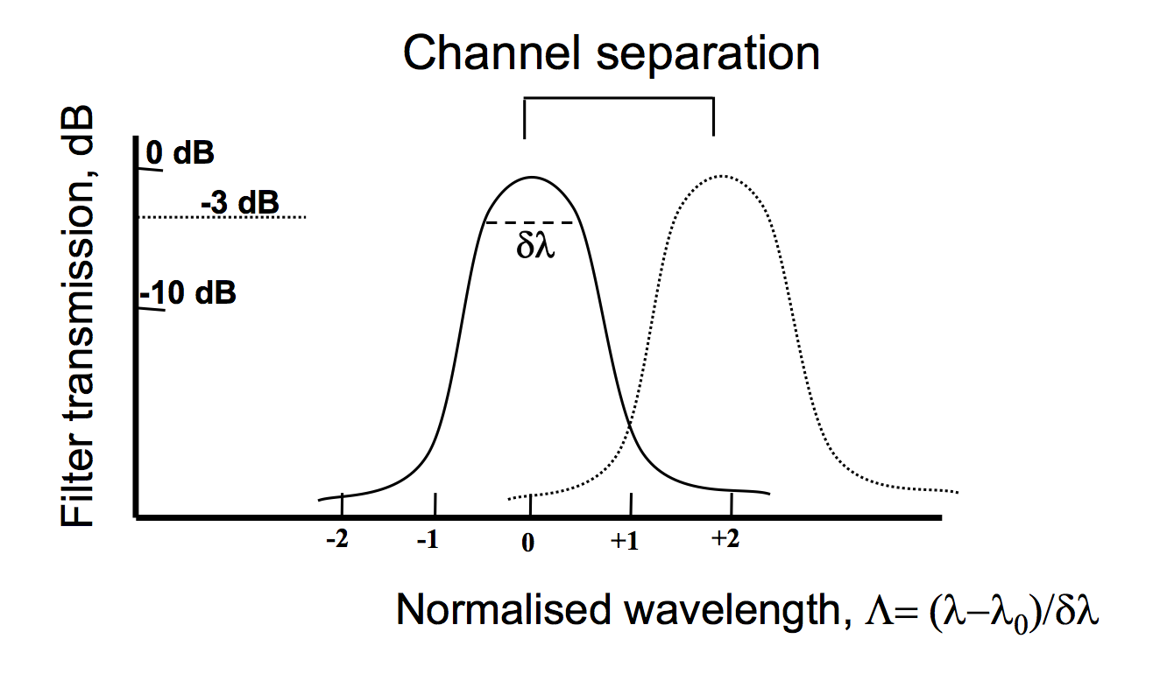
WDM Optical Filters
Optical Filters
Provide wavelength selection (demultiplexing/multiplexing)
Noise filtering (e.g. with optical amplifiers)
Gain equalisation
Filters are characterised by:
Loss, which depends on the technology used
Bandwidth, which depends on the design requirement
Selectivity, which depends on the filter construction

Slide 24
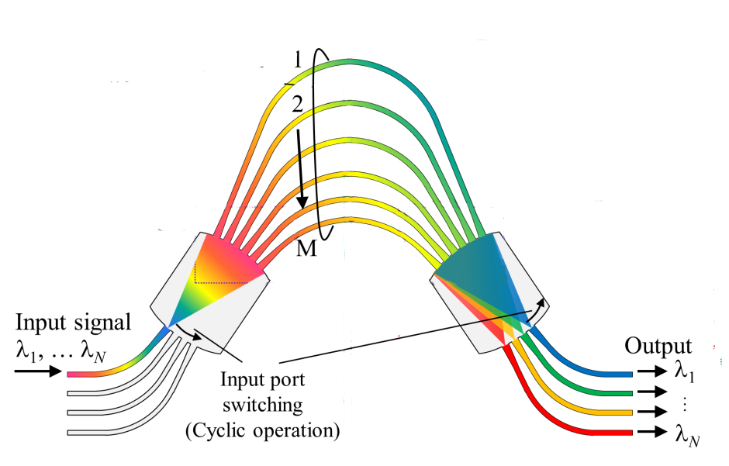
Optical WDM : Array Wave Guide
The input waveguides (1) enter a lens region (2)
(2) divides the power among the different waveguides in the grating array (3)
Each grating waveguide has a precise length difference ΔL with its neighbors
Light in each waveguide emerges with different phase delays ΔΦ at (4)
The second lens region (5) refocuses the light from all array waveguides onto the output waveguide array (6)
Each wavelength is focused into a different output waveguide in region (6)
Can act as both mux/demux and filter

Slide 25
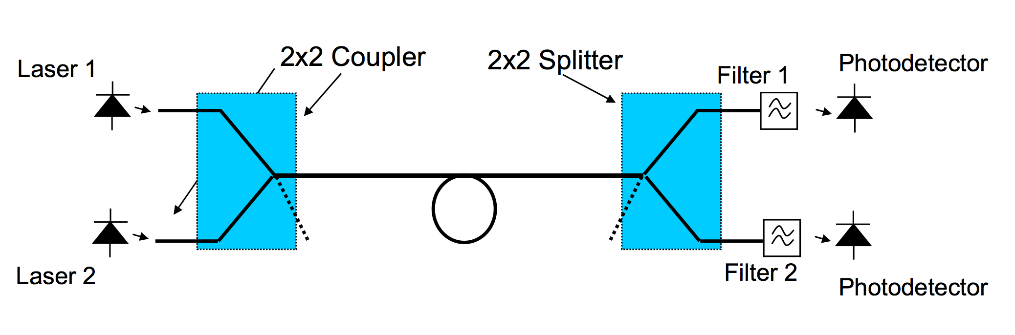
WDM Multiplexer/DeMultiplexer and Isolators
Reflections from fibre facet (about 4% reflected) enter the laser and can cause instabilities. This is particularly important at high bit rates

Slide 26
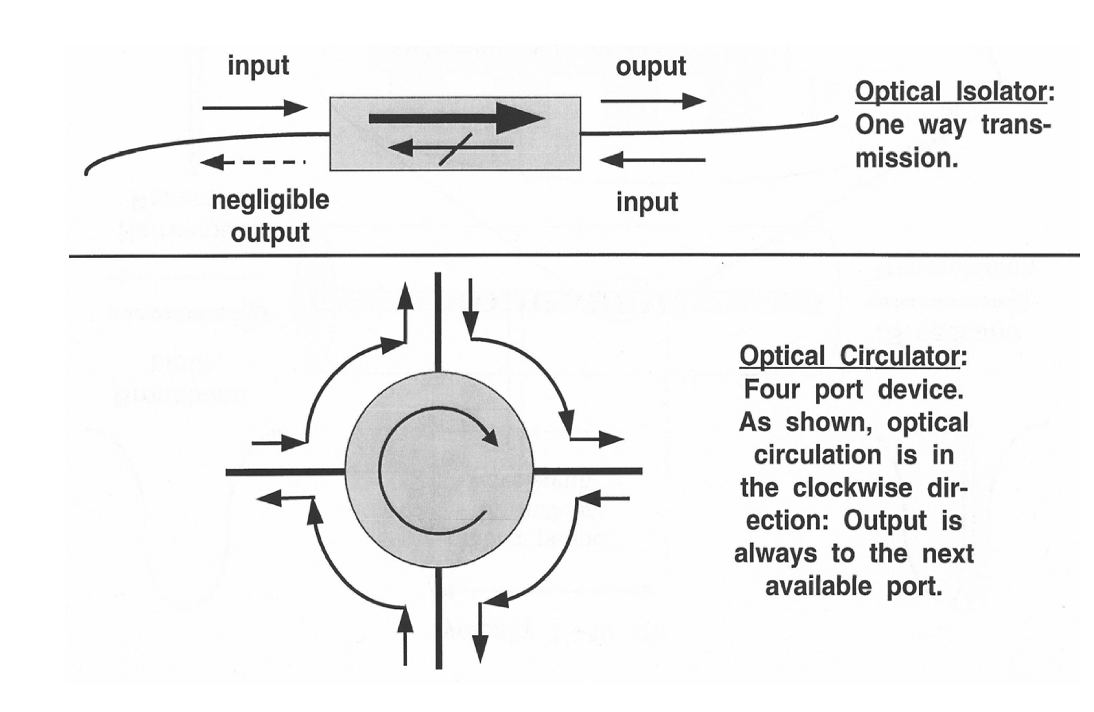
Isolator & Circulator

Slide 27
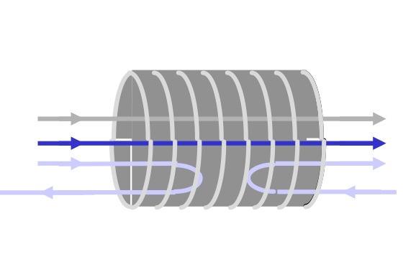
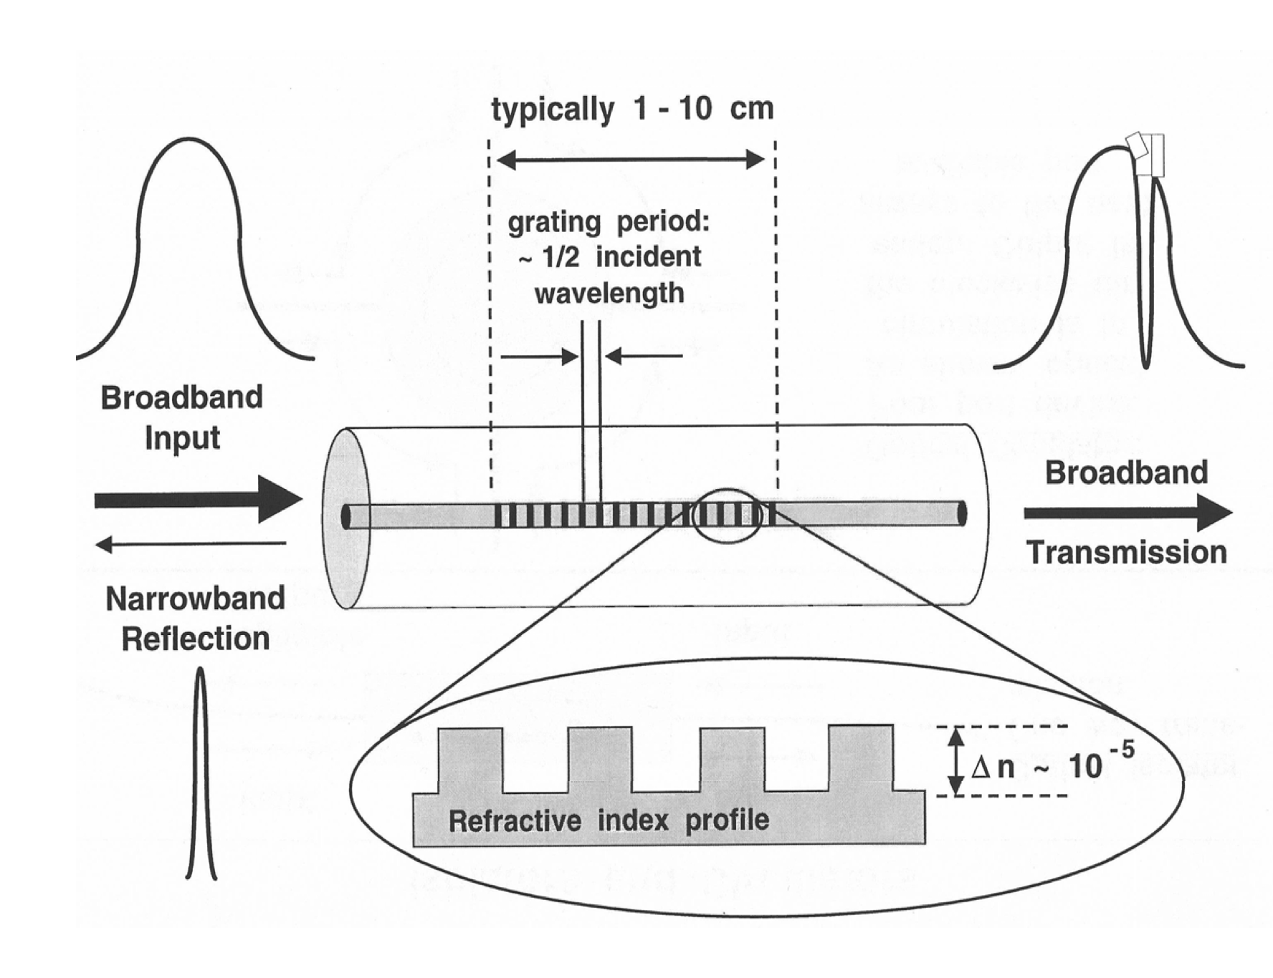
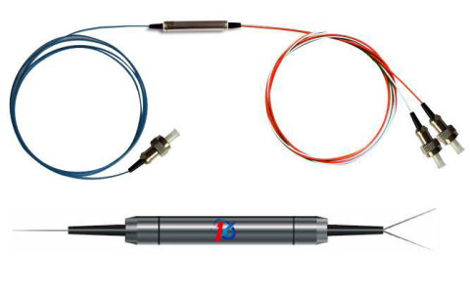
Fibre Gratings
Fiber gratings are ideal for WDM systems Reflection at precise optical frequencies
Attractive features in fiber gratings for WDM applications
Reproducibility
The relatively temperature insensitivity for filter elements made of silica( < 0.01 nm/oC)

Slide 28
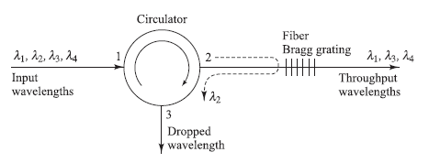
FBG and Circulator as Demux
Demultiplexing (wavelength dropping) process:
Consider 4 wavelengths entering a circulator at port 1.
All wavelengths exit from port 2.
The fiber Bragg grating is designed to reflect λ2 and pass all other wavelengths.
After reflection, λ2 enters port 2 and comes out of port 3.

Slide 29
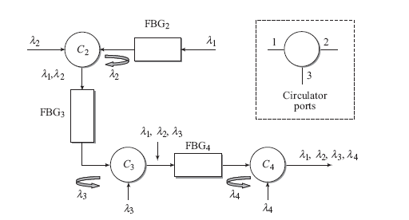
FBG and Circulator as Mux
One needs to cascade N-1 FBGs and N-1 circulators for combining or separating N wavelengths.
Example for multiplexing four wavelengths using three FBGs and three circulators (labeled C2, C3, and C4). The fiber grating filters labeled
FBG2, FBG3, and FBG4 are constructed to reflect wavelengths λ2, λ3, and λ4, respectively, and to pass all others.

Slide 30
Passive Star Network
Node 1
λ1, λ2,…., λn
TX3
Laser λ3
λ3
NXN
Coupler
λ1
λn
RX_{n}
λ1, λ2,…., λn
DMUX
λ1, λ2,…., λn
RX₁
Node 2
λ1
λ2
Node 3
λ1, λ2,…., λn
λn
Node N

Slide 31
Example
For 4 nodes star
What is size of coupler
How many wavelength do you need?
How many Transmitters do you need?
How many filter do you need ?

Slide 32
End of Session 3
Questions?

